Slide 1
University of Basrah Al-zahraa medical college
Ministry of higher Education and Scientific Research
The module: Tissue of the Body (TOB)
Semester 2 Session 8 Lecture 2
Blood cell and Haemopoiesis
Module staff: Dr. Ghada Lateef (Module Leader)
Dr. Ihsan Mardan Humod Dr. Hameed Abbas
Dr. Safa Assad Dr. Nawal Mustafa
Dr. Muntaha Abdul Hadi Dr. Nada Hashim
Dr. Iman Abdul Hadi Dr. Hussein Katie
Dr. Raed Jasim Dr. Rafid Mousa
Dr. Falih Waheed Dr. Ansam Munadhel
Color Atlas & Text of Histology 6thed: 2014
For more detailed instruction, any question, cases need help please post to the group of session.

Slide 2
Intended learning outcomes of this lecture:
At the end of this lecture you should be able to know :
Haemopoiesis: how the cellular components of the blood are derived from stem cells. (L.O.1).
Contrast the potential of white blood cells to mobilise, divide and transform, with that of cells derived from other organs of the body.(L.O.2).
Describe the structure and function of the following:
erythrocytes and reticular cells
lymphocytes
monocytes
granulocytes or polymorphonuclear leucocytes (i.e. neutrophils, basophils, eosinophils)
platelets(L.O.3).

Slide 3
Cells of the blood
LO: 1
Erythrocytes (red blood cells, RBC)
Platelets (thrombocytes)
Leukocytes (white blood cells, WBC)
Granulocytes (with specific granules)
Neutrophil (~60%)
Eosinophil (~4%)
Basophil (<1%)
Agranulocytes (without specific granules)
Lymphocyte (B-cell, T-cell) (~27%)
Monocyte (~8%)

Slide 4
LO: 1
Haemopoiesis (Haematopoiesis): is the process of production of mature blood cells from precursors.
All blood cells develop from a single pluripotential precursor cell known as the pluripotential haemopoietic stem cell (PHSC), these cells are capable of division and differentiation.
These cells undergo mitotic activity, whereby they give rise to two types of multipotential haemopoietic stem cells:
Myeloid progenitor cells
Lymphoid progenitor cells

Slide 5
LO: 1
Two main cell lines develop from stem cells – myeloid blasts and lymphoblasts (cells capable of division are termed blasts).
Myeloid blasts erythrocytes (red cells)
granulocytes (granules in the cytoplasm)
monocytes (macrophage precursors)
platelets
Lymphoblasts are the precursors of lymphocytes.
Lymphocytes leave the bone marrow and some pass through the thymus, transforming to T-cells (kill virus-infected cells - cellular immunity). Others are known as B-cells (they produce antibody molecules responsible for humoral immunity.

Slide 6
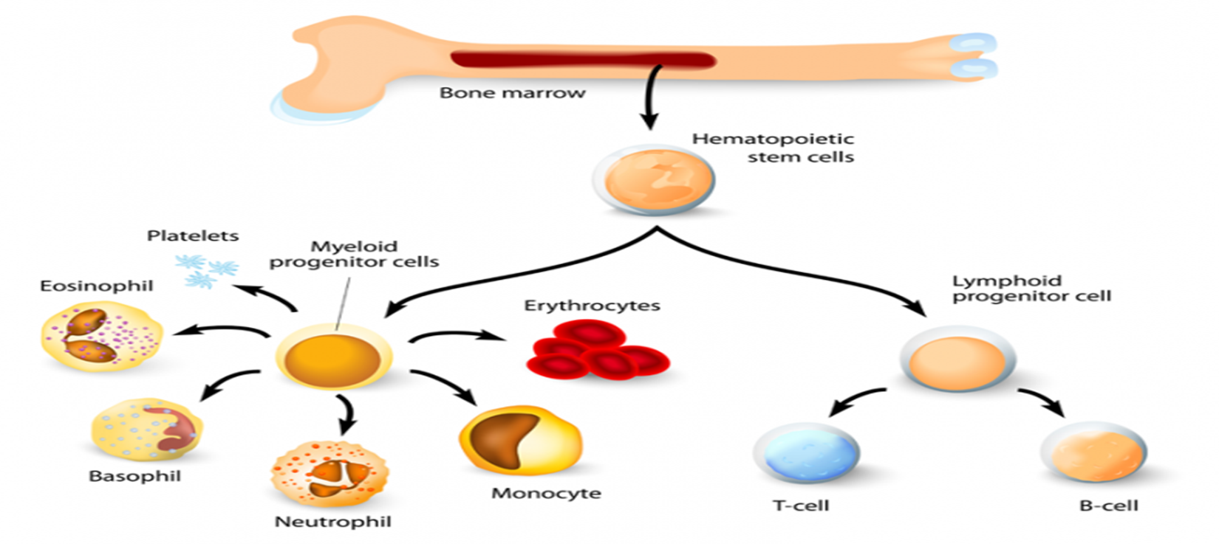
LO: 1

Slide 7
LO: 1
Haemopoiesis (Haematopoiesis): continue…
During foetal development, the formation of blood cells commences in mesoderm of the yolk sac.
After the second month of foetal development, the liver, and the spleen become the dominant sites of haemopoiesis.
From the 6th month, and dominating from the 7th month onwards, the formation of blood cells occurs in bone marrow, which is the major site of formation blood cells in normal adult man.

Slide 8
LO: 2
White blood cells:
The white cells in blood are a cell population in waiting, a reserve pool. When stimulated by chemotaxins and cytokine signals, they exit into tissue and become part of the inflammatory process.
Numbers in blood might be expected to fall as a result, but a large number of mature granulocytes sit in waiting, attached to the lining of small vessels. These form a functional reserve, not included in the blood count, but rapidly mobilised by the chemotaxins and cytokine signals of inflammation.

Slide 9
LO: 2
White blood cells: continue…
The same chemical signals stimulate movement of mature and almost mature cells in bone marrow into the circulating blood, forming an additional functional reserve.
These signals will also stimulate faster maturation of the existing immature granulocytes in the marrow, which forms yet another reserve, and stimulate increased cell production in marrow from stem cells; this is a slower process.

Slide 10
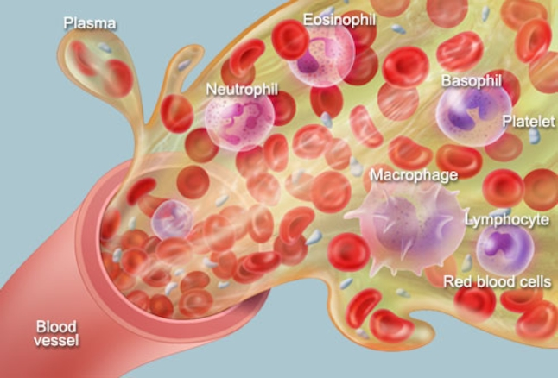
Cells of the blood
LO: 3
© 2014 WebMD, LLC. All rights reserved.

Slide 11
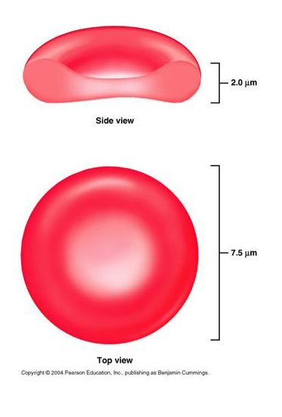
LO: 3
Red Blood Cell (R.B.C) or Erythrocyte
The mature human R.B.C is :
A circular, biconcave and non- nucleated cell.
Soft, flexible and readily be squeezed through narrow capillaries.
Internally composed of a framework which is built of many lipids and proteins, and gap within the framework is filled with haemoglobin.
Life span is about 120 days.

Slide 12
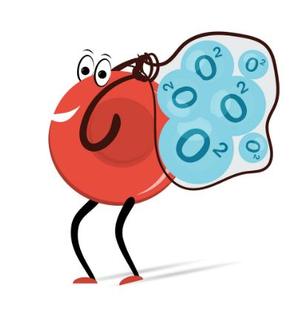
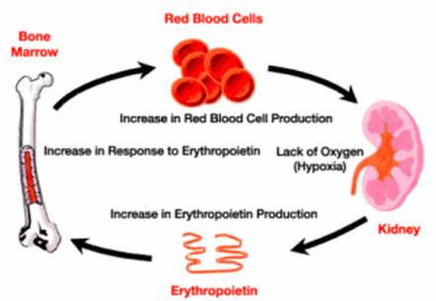
LO: 3
Red Blood Cell (R.B.C) or Erythrocyte
Function: carry oxygen from the lungs to all the tissues of the body, and to transport CO2 back to the lungs through haemoglobin.
Red cell production is regulated by a feedback system which increases the production of erythropoietin from peritubular endothelial cells in the kidney, in response to hypoxia.

Slide 13
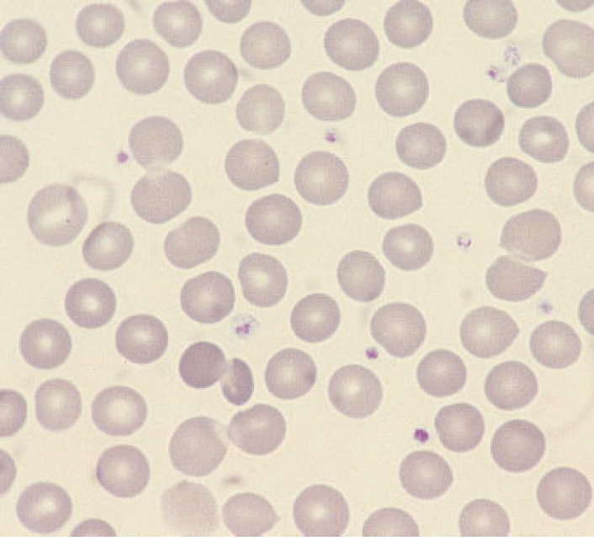
LO: 3
Red Blood Cell (R.B.C) or Erythrocyte
Normal red cells (erythrocytes) showing little variation in size and shape, an approximately round outline and a small area of central pallor in some of the cells. The small lilac-staining structures between the red cells are platelets.

Slide 14
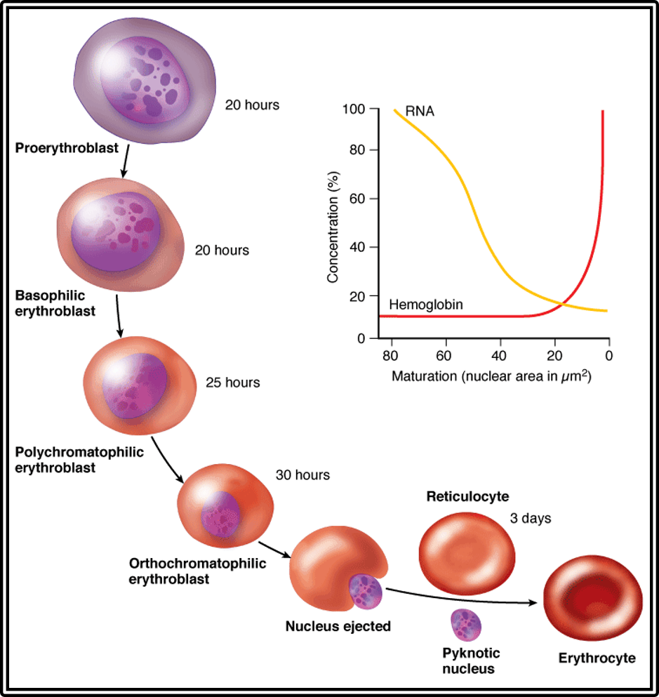
LO: 3
Erythropoiesis
Erythrocyte development image (above) lifted from histonano.com

Slide 15
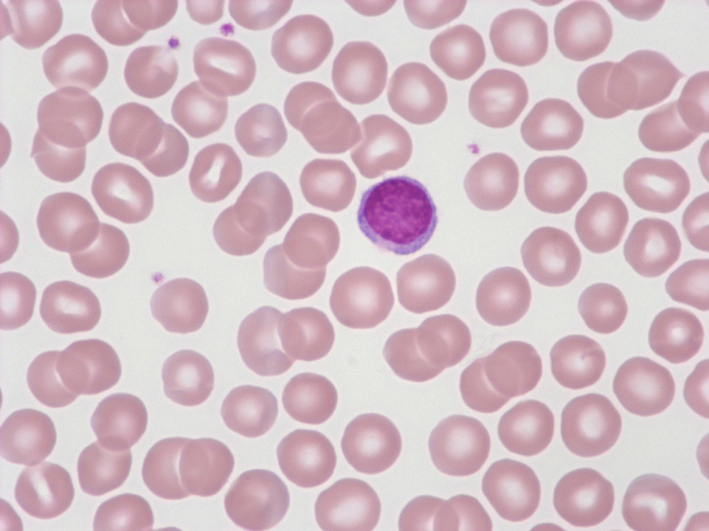
lymphocyte
LO: 3

Slide 16
LO: 3
Lymphocytes:
These are small cells with a round nucleus and a rim of pale blue cytoplasm.
Life Span is variable (few days to several years).
The three types of lymphocytes (B-lymphocytes, T-lymphocytes and null cells) are morphologically indistinguishable.
Function: Lymphocytes are the basic cells of the immune system.
T lymphocytes are responsible for cellular immunity, which are processed by the thymus.
B lymphocytes are responsible for humoral immunity.

Slide 17
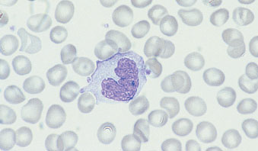
Monocyte
LO: 3
A monocyte, showing a lobulated nucleus and voluminous, opaque cytoplasm containing very fine azurophilic granules

Slide 18
Monocytes:
LO: 3
These cells are large, with a folded nucleus, grey/blue cytoplasm and occasional vacuoles.
Their nucleus less dense than lymphocytes; deeply indented, kidney or C-shaped.
They can move out of the circulation and migrate to become macrophages in many other organs of the body.
Function:
constitute mononuclear phagocyte system that help destroy foreign bodies. Tissue macrophages {Kupfer cells (liver), Osteoclasts (bone), Dust cells (lungs), Microglia (brain)}.
Mediate inflammatory response and Interact with T cells.

Slide 19
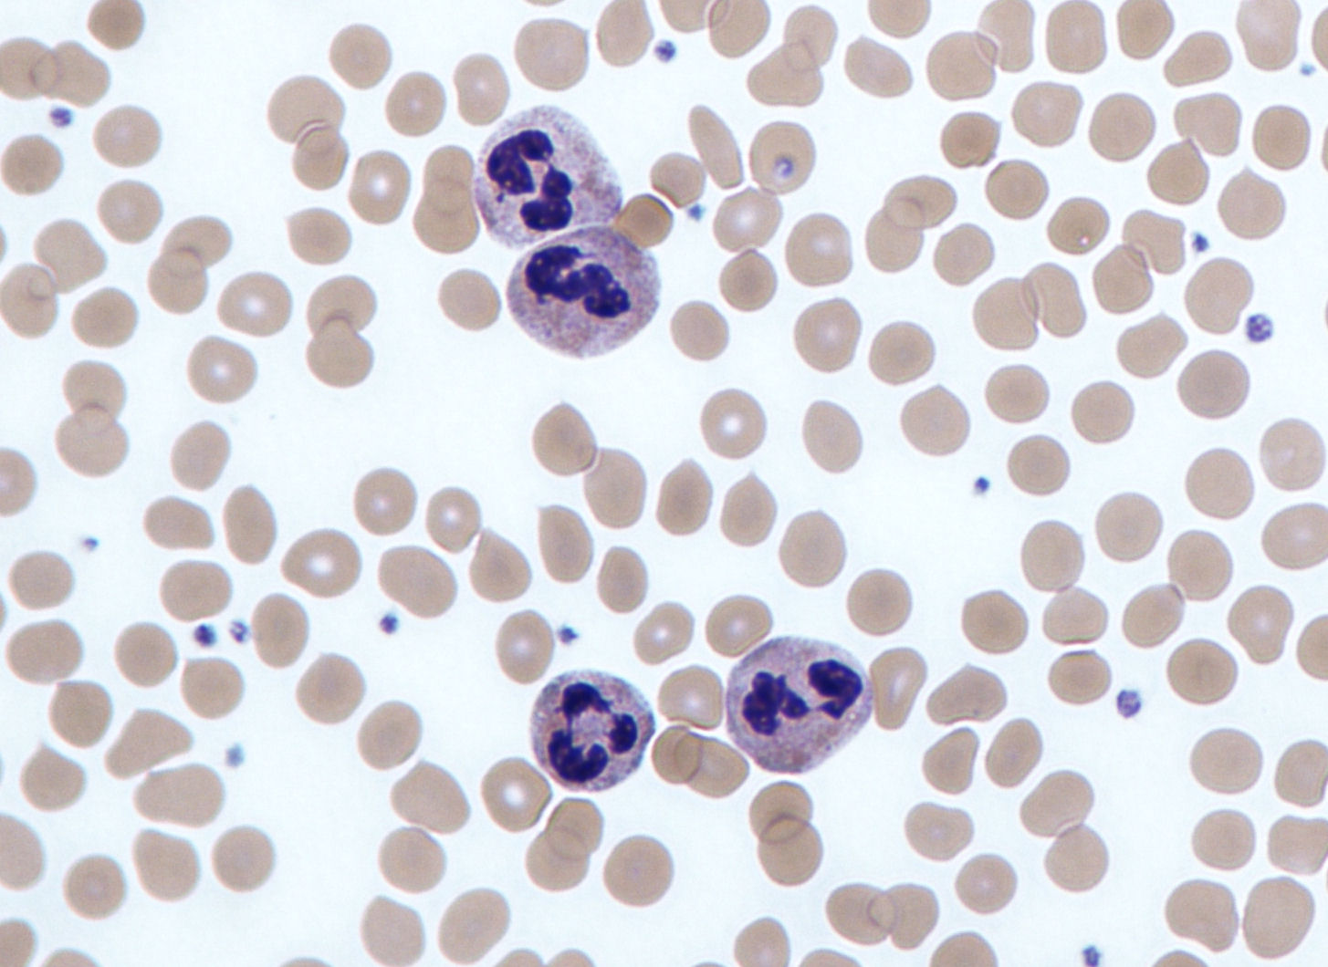
Neutrophils:
LO: 3

Slide 20
Neutrophils:
Neutrophils have a single nucleus segmented into multiple lobes (3-5 lobes), assuming variable shapes that led to the use of the term polymorphonuclear leukocytes or polymorphs.
Lifespan is about 10 hours inside blood vessels, and then pass to the connective tissue where they last for another 10 hours.
Function:
Primarily antibacterial
Neutrophils leave the blood and follow chemotaxic signals to sites of inflammation, and phagocytose foreign agents such as bacteria. Pus is composed largely of dead neutrophils.
LO: 3

Slide 21
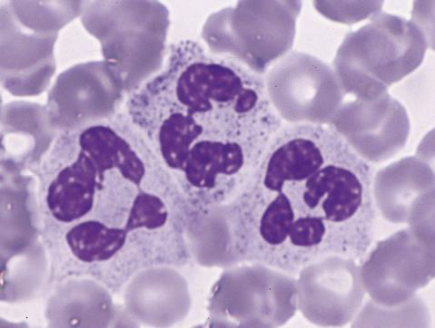
LO: 3
Neutrophilia: Means increased number of neutrophils in circulation as in acute bacterial infection, tissue injury and malignancy.
Neutropenia: Means decreased number of neutrophils in circulation as in viral infection, chronic bacterial infection such as typhoid fever and tuberculosis.

Slide 22
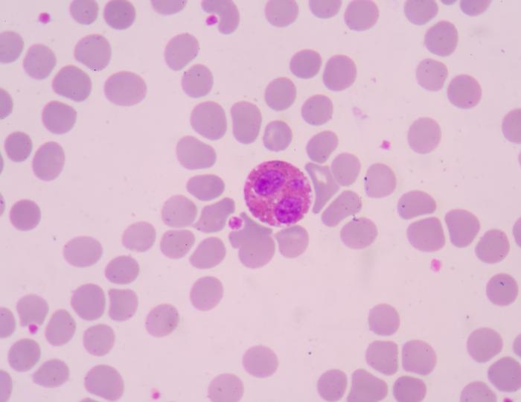
Eosinophils:
LO: 3
A normal bilobed eosinophil. The granules are reddish-orange and pack the cytoplasm.

Slide 23
LO: 3
Eosinophils:
Eosinophils are slightly larger than neutrophils. Their nuclei usually have two lobes that hidden by the numerous granules, which cover almost all of the cytoplasm.
Life span in blood is for 3 to 8 hours before migrating to connective tissue where they last for 10-12 days.
Function:
Anti-parasitic activity
Mediators of inflammatory/allergic responses in tissues.

Slide 24
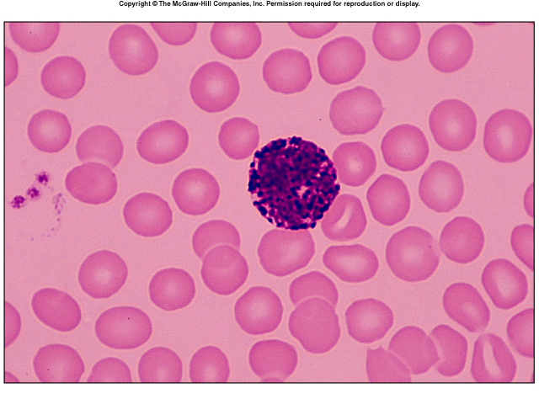
Basophils:
LO: 3
A normal basophil. The nucleus has three lobes. The cytoplasm is packed with large purple granules.

Slide 25
LO: 3
Basophils:
Small granulocytes with a diameter of 8 to 10μm.
Their nucleus is bilobed which hidden by the large cytoplasmic granules.
Function:
Heparin and histamine are vasoactive substances, dilate the blood vessels, make vessel walls more permeable and prevent blood coagulation.
They facilitate the access of lymphocytes and other antibodies to the site of infection

Slide 26
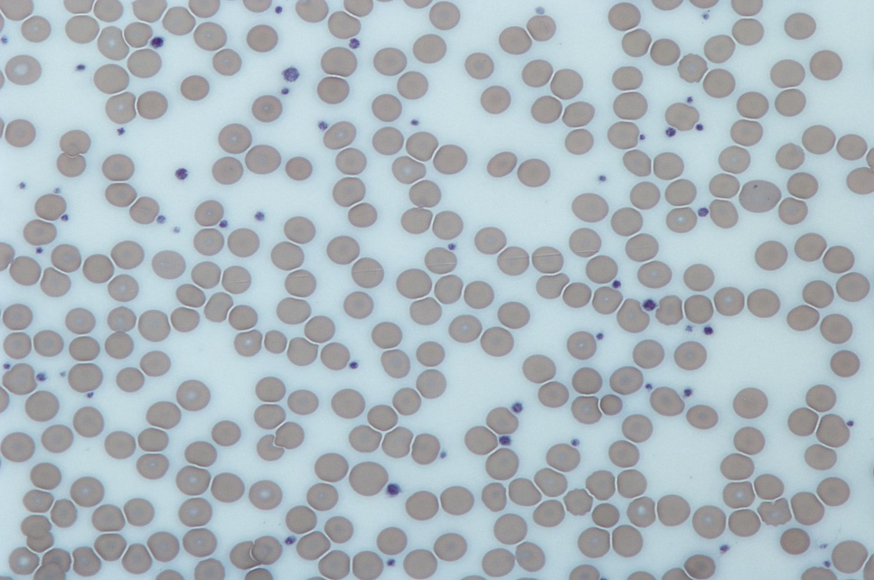
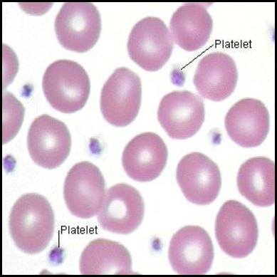
Platelets (thrombocytes)
Life Span: about 10 days.
Shape, size, and origin: Small, biconvex disks, 2-3 µm in diameter. Non-nucleated cell fragments derived from cytoplasm of a very large cell (megakaryocyte) in bone marrow.
LM appearance in smears: Small basophilic fragments, often appearing in clusters.
Function: Platelets initiate blood clots.

Slide 27
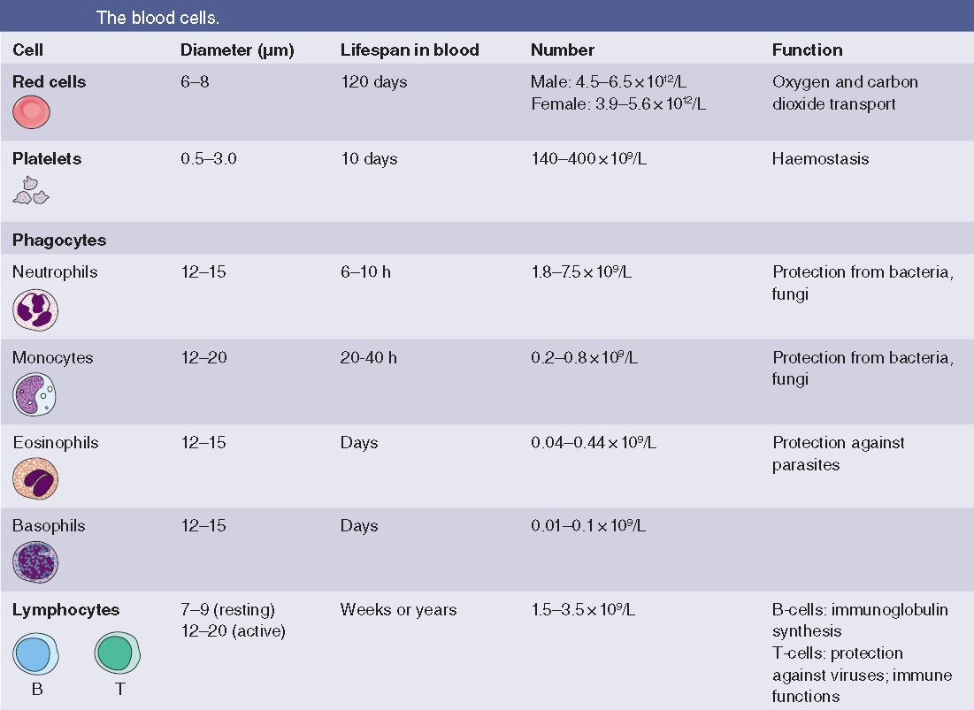

Slide 28
